Slide 1
2. Social Network Structure, Measures & Visualization
Amit Aylani

Slide 2
Contents
Basics of Social Network Structure - Nodes, Edges & Tie
Describing the Networks Measures - Degree Distribution, Density,
Connectivity, Centralization, Tie Strength & Trust
Network Visualization - Graph Layout, Visualizing Network features,
Scale Issues.
Social Media Network Analytics - Common Network Terms, Common
Social Media Network Types, Types of Networks, Common Network
Terminologies, Network Analytics Tools.

Slide 3
Basics of social network structure
Social network structure refers to the patterns of relationships and connections among a group of people or organizations.
Studying social network structure helps us understand how information, resources, and support flow within a group, and how this flow impacts the behavior and outcomes of individuals and organizations.
Social network analysis is a research methodology that uses mathematical and statistical techniques to analyze and visualize social network data.
By studying social network structure, we can gain insights into the structure and dynamics of social systems, and how these systems influence the behavior and outcomes of individuals and organizations within them.

Slide 4
Node in Social Media Network
A node refers to an individual, organization, or group that is represented by a point in the network.
A node is connected to other nodes by lines or edges, which represent relationships or connections between the nodes.
These connections can be based on various factors, such as friendships, familial relationships, shared interests, or professional connections.

Slide 5
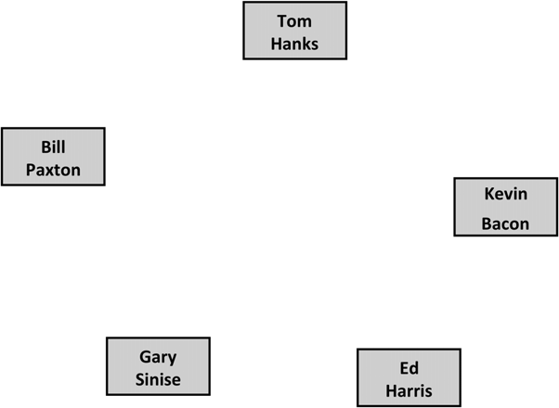
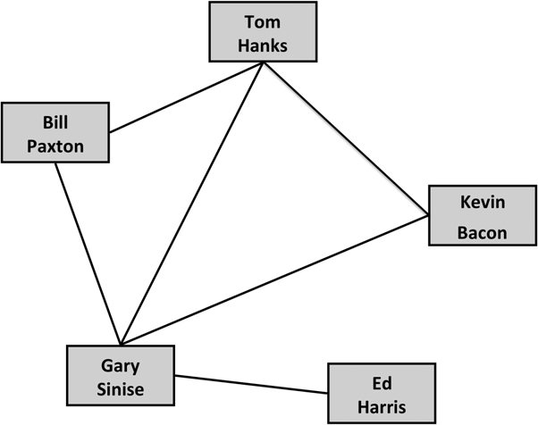
Node in Social Media Network
The five co-stars of Apollo 13. Each is represented as a node in the network.
The edges connect actors who were in movies together.

Slide 6
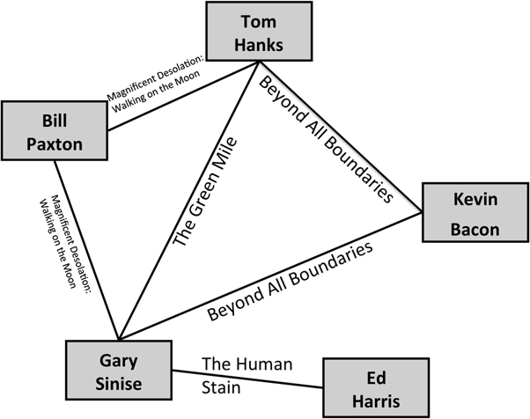
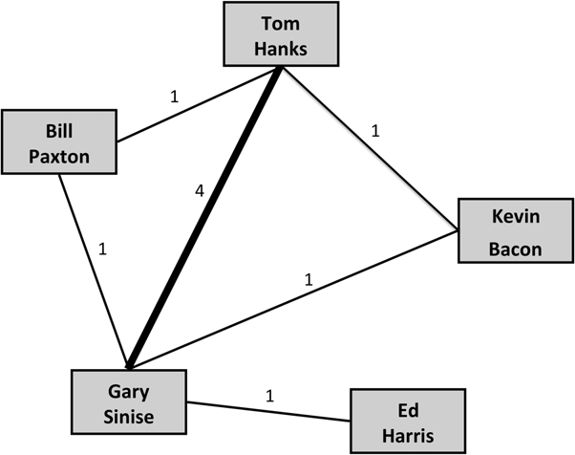
Undirected Graph
A weighted graph where weights are indicated both as numbers and by the thickness of the edge. In this graph, weight indicates how many movies the actors have been in together.
Edges indicate at least one movie that the actors have been in together, not including Apollo 13.

Slide 7
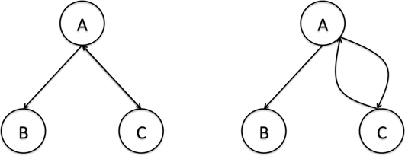
Directed Graphs

Slide 8
Representing Networks : Text Based Visualizations
Adjacency Lists
An adjacency list, also called an edge list. Each edge in the network is indicated by list- ing the pair of nodes that are connected. For example, the adjacency list for the Apollo 13 network is as follows:
Tom Hanks, Bill Paxton
Tom Hanks, Gary Sinise
Tom Hanks, Kevin Bacon
Bill Paxton, Gary Sinise
Gary Sinise, Kevin Bacon
Gary Sinise, Ed Harris

Slide 9
Representing Networks : Text Based Visualizations
Adjacency Lists
Adjacency lists can also include additional information about the edges
Tom Hanks, Bill Paxton, 1
Tom Hanks, Gary Sinise, 4
Tom Hanks, Kevin Bacon, 1
Bill Paxton, Gary Sinise, 1
Gary Sinise, Kevin Bacon, 1
Gary Sinise, Ed Harris, 1

